Slide 1

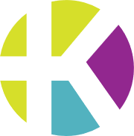
Kahlo Portal App
Ramon Flores

Slide 2

Overview
Our existing web team member portal is fully operational, stable, and already used daily by team members. It serves as the central hub for time management, scheduling, and viewing personal stats.
The next step is to expand this ecosystem by introducing mobile-native applications. By bringing our platform to Android and iOS, we aim to increase accessibility, reduce tardiness, streamline communication, and give staff the tools they need wherever they are; directly on their phones.
This mobile expansion builds on the success of the web portal while enabling features only possible on mobile devices, such as real-time notifications, location-aware reminders, and uploading photos directly to the cloud.

Slide 3




The Problem
Tardiness issues
Team members arriving late to their shifts for example, showing up at 3:00 PM instead of 2:00 PM despite having a posted schedule. Even a few late arrivals per month can significantly disrupt operations and productivity.
“I didn’t remember” a common excuse
Although the full schedule is available on the portal, team members often forget to check it regularly. Without a proactive reminder system, memory becomes the weakest link.
Web portal depends on user initiative
The website requires team members to remember to log in, navigate to the schedule, and check for changes. If they don’t take that initiative, they stay uninformed.
No push notifications or real-time alerts
Since the web version can’t send native notifications, important updates such as schedule changes, reminders, or shift alerts often go unnoticed, resulting in miscommunication or missed shifts.

Slide 4

Why a Mobile App Fixes This
01
03
Native push notifications
Team members receive real-time alerts for upcoming shifts, schedule changes, and important updates making it far less likely for critical information to be missed.
Instant, one-tap access to the schedule
No need to open a browser and log in. The schedule is available instantly inside the app, increasing the likelihood that team members check it regularly.
02
04
Lock-screen visibility
Notifications appear right on the lock screen, where they are hard to ignore. This dramatically reduces “I forgot” moments and helps prevent late arrivals.
Designed for a mobile-first workforce
Most team members live on their phones. A mobile optimized experience meets them where they already are, driving higher engagement and consistent usage compared to a traditional web-only portal.

Slide 5

A.
Backend already supports automated reminders
C.
Better communication = fewer misunderstandings
The current system is capable of generating reminders and schedule alerts—but those reminders lose impact when delivered through channels that team members rarely check.
A unified communication channel ensures managers and team members stay aligned. Clearer, faster communication directly cuts down on missed shifts, confusion, and operational slowdowns.
C
B
D
D.
Real potential to reduce tardiness
Mobile app dramatically improves visibility & timing
A
E
Even lowering late arrivals by 2–3 times per month can significantly improve store productivity, customer flow, and team efficiency. Immediate alerts help eliminate forgetfulness as an excuse.
B.
Notifications
=
Behavior Change
By delivering reminders straight to the lock screen via native push notifications, team members see them immediately. The timing can be optimized for example, sending alerts 1 hour before a shift or when travel time indicates they should leave.
Solution
E.
Improves punctuality and manager workflow
Managers spend less time reminding staff, chasing updates, or adjusting shifts last-minute. With better visibility and automated reminders, daily operations become smoother and more predictable.

Slide 6

Productivity Impact
Even cutting 2–3 late arrivals per month is a major improvement
Small wins add up. Preventing just a handful of late shifts each month significantly stabilizes daily operations.
Late arrivals disrupt opening tasks, customer service, and overall team flow
When one person is late, everything slows down: prep work gets delayed, customers wait longer, and other team members have to compensate.
Small reductions multiply over time and across the entire team
A few fewer late shifts each month becomes dozens over the year especially when applied across multiple team members. The cumulative effect is substantial.
Higher punctuality leads to smoother operations and increased productivity
Consistent on-time attendance creates predictable workflows, reduces manager stress, and boosts the overall efficiency of the salon.

Slide 7
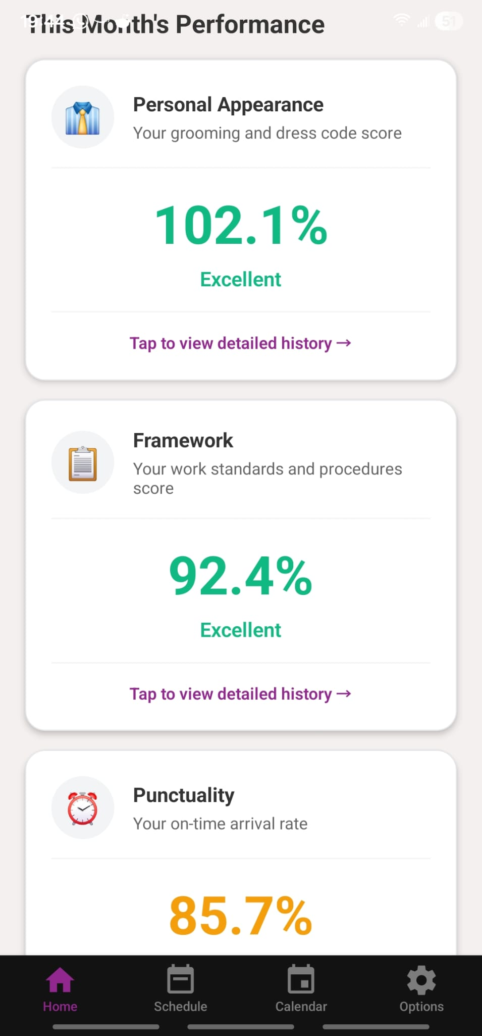
Home Page
in progress
Working
Quick overview
Color coded green, yellow, red
To-Do
Different screen for managers
more stats

Slide 8
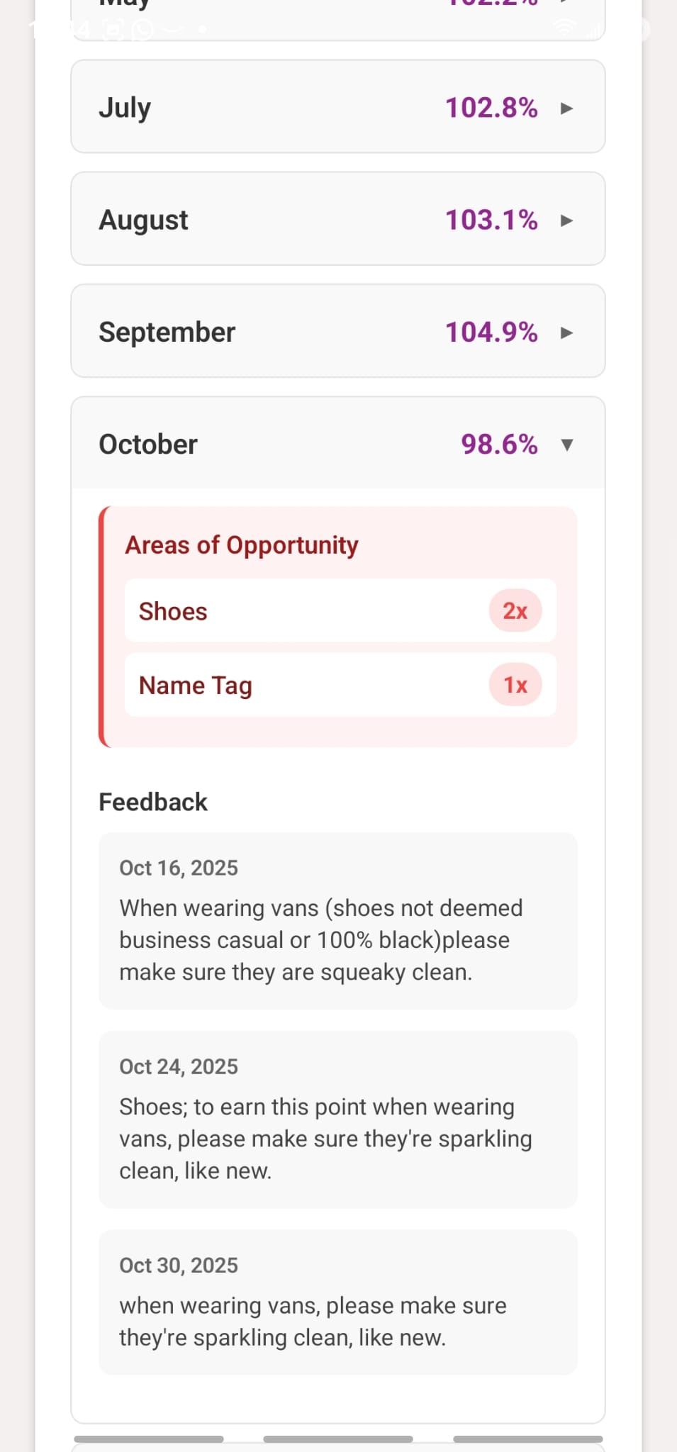
Personal Appearance
in progress
Working
Graph
Monthly scores
Feedback and areas of opportunity
To-Do
Awards
Push notifications
Metric description
Color coded actual values

Slide 9
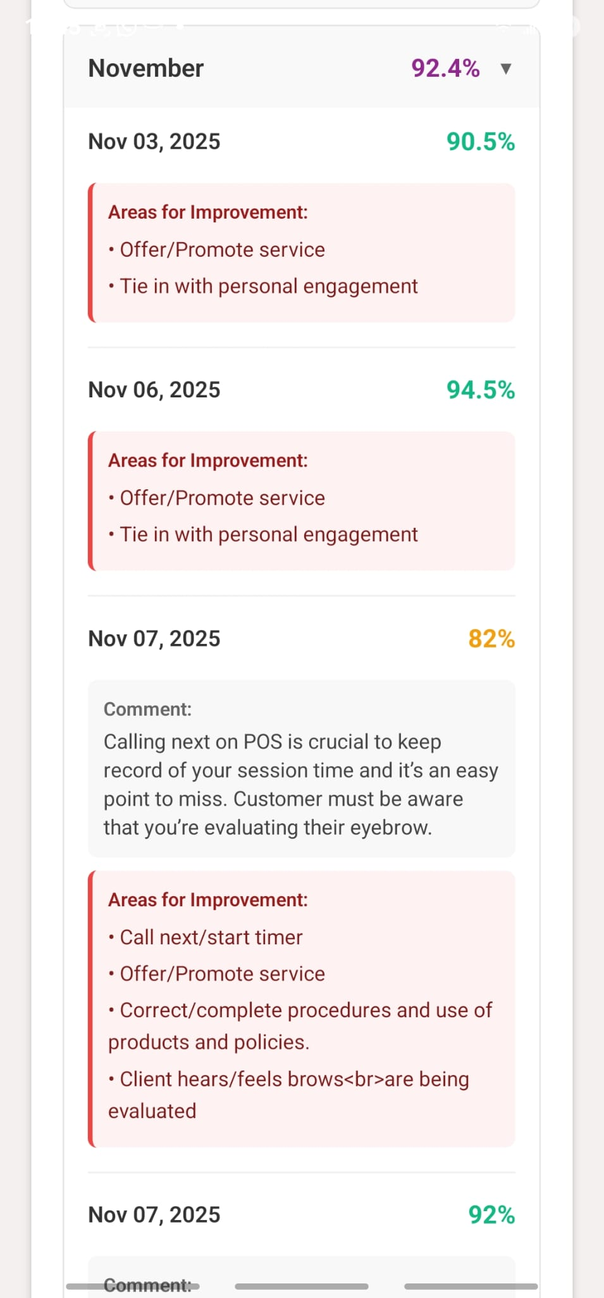
Framework
in progress
Working
Graph
Monthly scores
Feedback and areas of opportunity
To-Do
Awards
Push notifications
Metric description
Color coded actual values

Slide 10
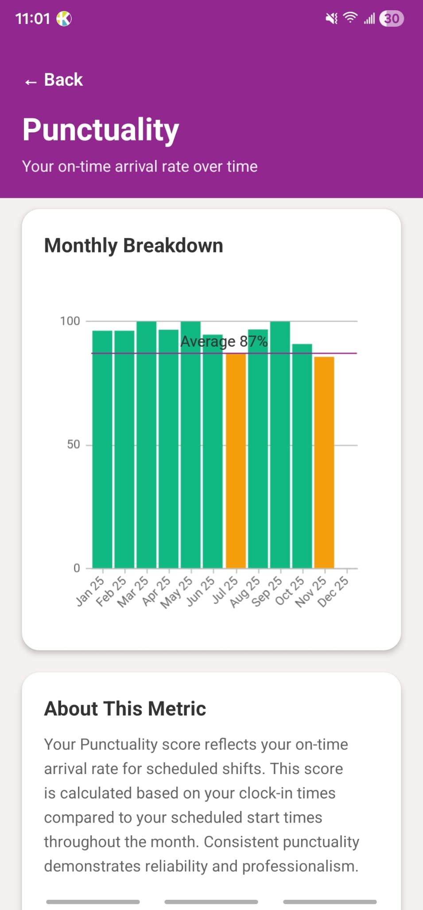
Punctuality
in progress
Working
Graph
Monthly scores
To-Do
Metric description
Color coded actual values
Verify average

Slide 11
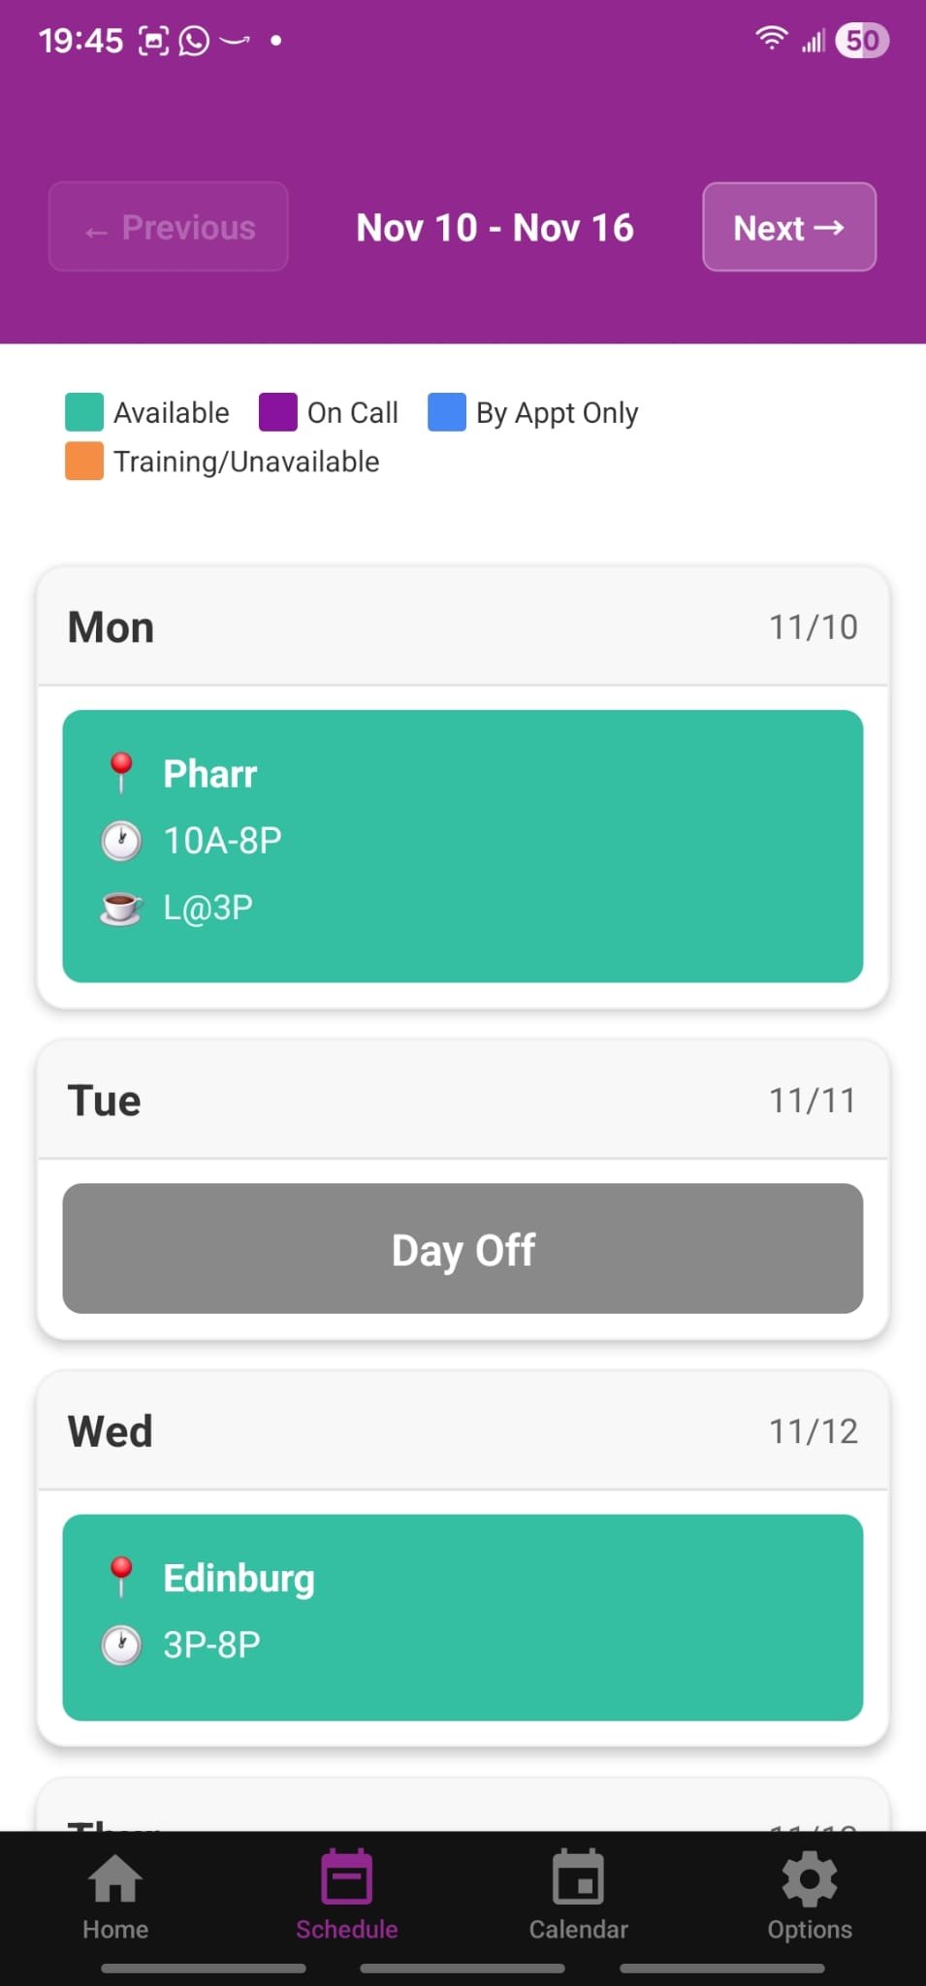
Schedule
in progress
Working
Shows schedule
Shows notes for shift
Shift reminders
Smart schedule notifications
To-Do
Notes for all team members

Slide 12
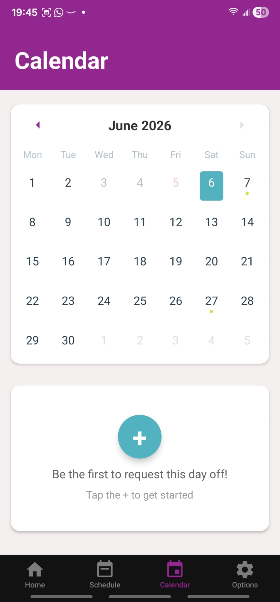
Calendar
in progress
Working
Block dates show as gray
Limited dates show as light red
Shows requests in priority order
To-Do
Request time off form
Show current RTO/PTO
Push notifications for Kahlo Events

Slide 13

Potential App Features
Built-in secure messaging for fast communication The app can include a private, secure chat system where managers and staff can instantly communicate shift changes, updates, or urgent notes—all in one place and tied directly to the schedule.
Location-Aware Smart Reminders
Estimated drive-time alerts Using optional location access, the app can calculate approximate travel time to the salon and send a “Leave Now to Arrive on Time” alert if an employee is running behind.
Geo-triggered clock-in reminders When staff arrive near the salon, the app can remind them to clock in or review last-minute shift notes.
Adaptive reminder system The app can learn patterns—such as who tends to cut it close—and proactively send earlier or smarter reminders to prevent habitual lateness.
Photo upload directly to social media manager
Staff can take photos and instantly upload them to the salon’s social media management system. This streamlines content collection and reduces manual steps for managers.
Automated social media photo reminders
The app can send reminders to staff to capture and submit photos at the right times—helping ensure consistent content posting and stronger online engagement.

Slide 14

Moving Forward
Next Steps for Testing and Launch

Slide 15






01
02
02
Recruit 12 testers for Google Play Closed Testing
Android testing is available now
Android testing is available now
Running a closed test with 12 participants will meet Google Play requirements and provide valuable early feedback.
The app is ready for Android testers using the same codebase as iOS, allowing simultaneous testing across platforms.
The app is ready for Android testers using the same codebase as iOS, allowing simultaneous testing across platforms.
2

Slide 16
02
02
02
01
03
Recruit 12 testers for Google Play Closed Testing
Cross-platform development with VS Code + Expo
Android testing is available now
Android testing is available now
Android testing is available now
The app is ready for Android testers using the same codebase as iOS, allowing simultaneous testing across platforms.
The app is ready for Android testers.
The app is ready for Android testers using the same codebase as iOS, allowing simultaneous testing across platforms.
Running a closed test with 12 participants will meet Google Play requirements and provide valuable early feedback.
The app is built in a single codebase that works for both Android and iOS, simplifying development, updates, and maintenance.
2
2

Slide 17
02
02
04
03
02
Cross-platform development with VS Code + Expo
Android testing is available now
Android testing is available now
iOS version already fully functional
Android testing is available now
The app is ready for Android testers.
The app is ready for Android testers using the same codebase as iOS, allowing simultaneous testing across platforms.
The same codebase works 100% on iOS, reducing development effort and ensuring feature parity across platforms.
The app is built in a single codebase that works for both Android and iOS, simplifying development, updates, and maintenance.
The app is ready for Android testers using the same codebase as iOS, allowing simultaneous testing across platforms.
2
2
2
2

Slide 18
03
04
05
02
02
Cross-platform development with VS Code + Expo
Apple Developer account required to publish
iOS version already fully functional
Android testing is available now
Android testing is available now
The app is built in a single codebase that works for both Android and iOS, simplifying development, updates, and maintenance.
The same codebase works 100% on iOS, reducing development effort and ensuring feature parity across platforms.
A $99/year Apple Developer fee is needed to release the app on the App Store.
The app is ready for Android testers using the same codebase as iOS, allowing simultaneous testing across platforms.
The app is ready for Android testers using the same codebase as iOS, allowing simultaneous testing across platforms.
2
2
2
2

Slide 19
04
02
05
Apple Developer account required to publish
iOS version already fully functional
Android testing is available now
The same codebase works 100% on iOS, reducing development effort and ensuring feature parity across platforms.
The app is ready for Android testers using the same codebase as iOS, allowing simultaneous testing across platforms.
A $99/year Apple Developer fee is needed to release the app on the App Store.
2
2

Slide 20

Closing
App enhances an already successful system
The existing web portal is widely used and effective, but the mobile app takes it a step further by meeting staff where they are—on their phones making the system more accessible, immediate, and actionable.
Push notifications and ETA features reduce avoidable lateness
Real-time alerts, lock-screen reminders, and optional location-based travel-time guidance ensure team members see their shifts on time and know exactly when to leave, eliminating common causes of tardiness.
Even small improvements in punctuality translate into meaningful gains
Reducing just a few late arrivals per month improves team flow, customer service, and operational efficiency. Over time, these small improvements compound across multiple team members, leading to measurable productivity gains for the salon.
Test Notifications

